Slide 1
Connecting & Computer Preliminaries
Make sure your workshop provided computer is connected to the “Broad” or “Broad Internal” wireless network.
The Google Chrome Browser is required

Slide 2
Introduction to single-cell RNA-Seq
Center for Cell Circuits Computational Genomics Workshop 2017
Brian Haas
Asma Bankapur
Timothy Tickle
Caroline Porter
Orr Ashenberg

Slide 3
We Know Tissues are Heterogeneous
Notes:
Lamina Propria- loose connective tissue
Peristalsis
Eosinophil-white blood cell that stains well with Eosin.
Band neutrophil/Segmented neutrophil-Neutrophils, are also known as "segs", "PMNs" or "polys" (polymorphonuclears). They are the body's primary defense against bacterial infection and physiologic stress.
Basophil-white blood cell
Platelet-blood coting
lymphocyte-immune system
Monocyte-a large phagocytic white blood cell with a simple oval nucleus and clear, grayish cytoplasm.

Slide 4

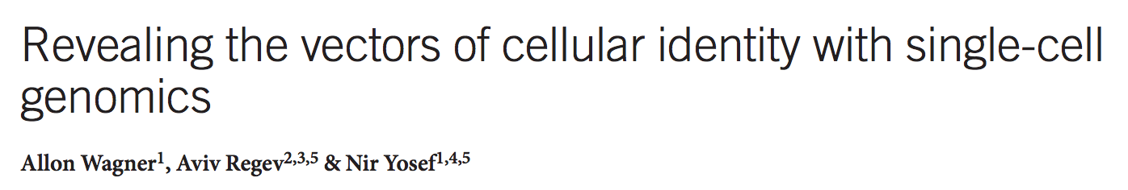
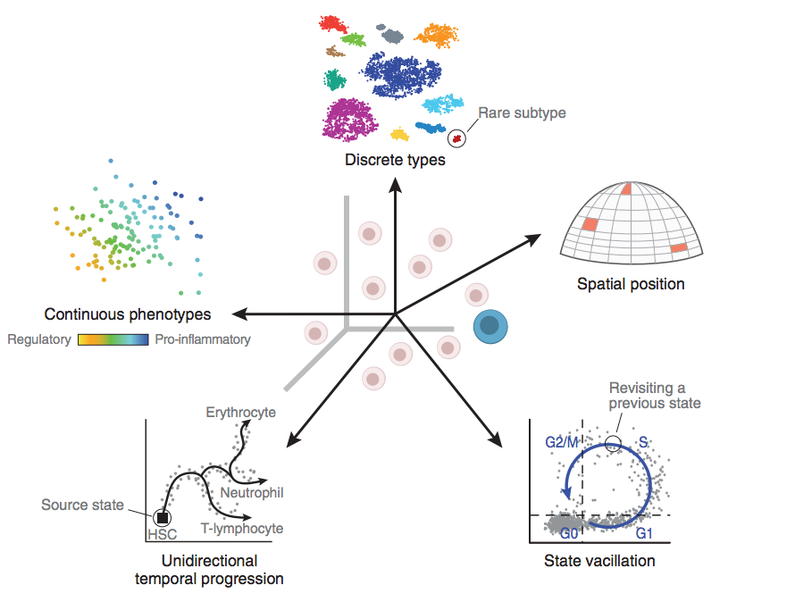
Cell Identity is More Than Histopathology
Many facets to
cellular biology
Multiple factors shape a cell’s identity
Membership in a taxonomy
of cell types
Simultaneous time-
dependent processes
Response to the
environment
Spatial positioning

Slide 5
We Will Attempt to Cover
Initial data exploration.
Gene and cell filtering.
Dimensional Reduction and plotting cells.
Clustering cells
Differential expression.
Communicating your study.

Slide 6
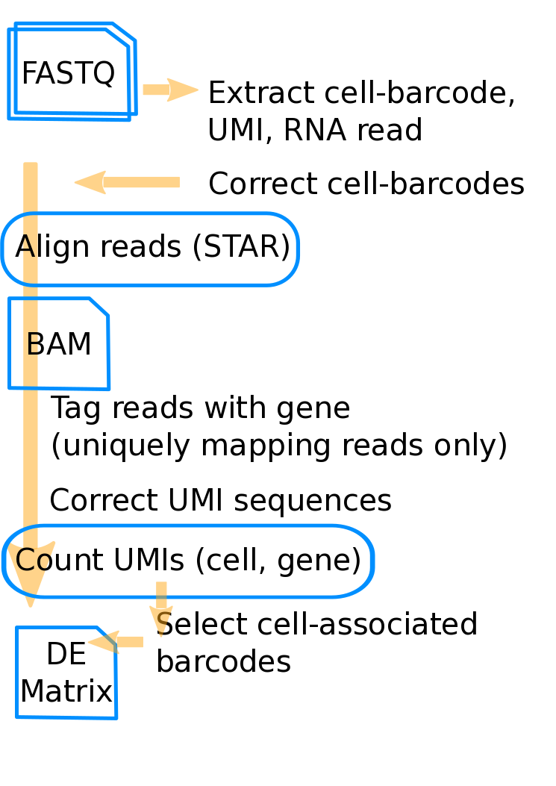
A General scRNA-Seq Pipeline Overview
Count Matrix

Slide 7
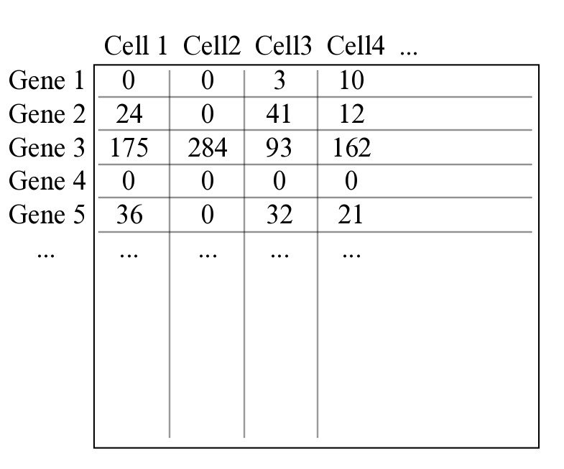
This is an Expression Matrix

Slide 8
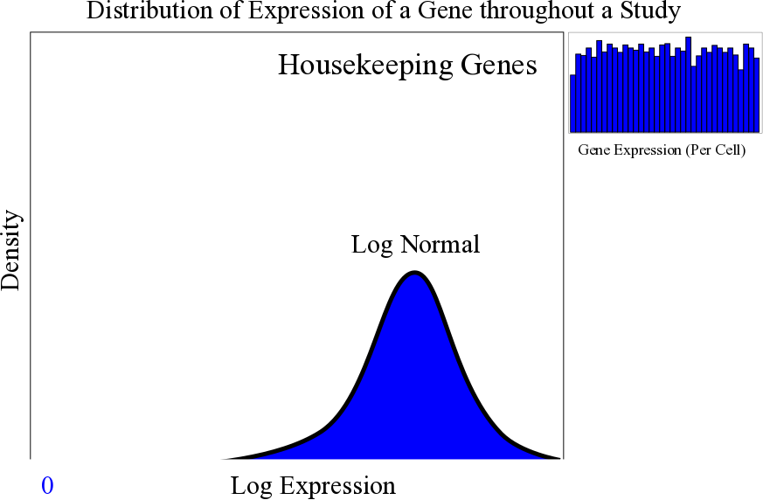
Genes Have Different Distributions

Slide 9
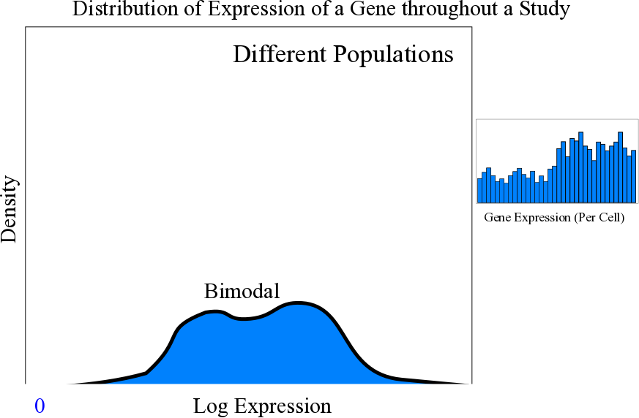
Genes Have Different Distributions

Slide 10
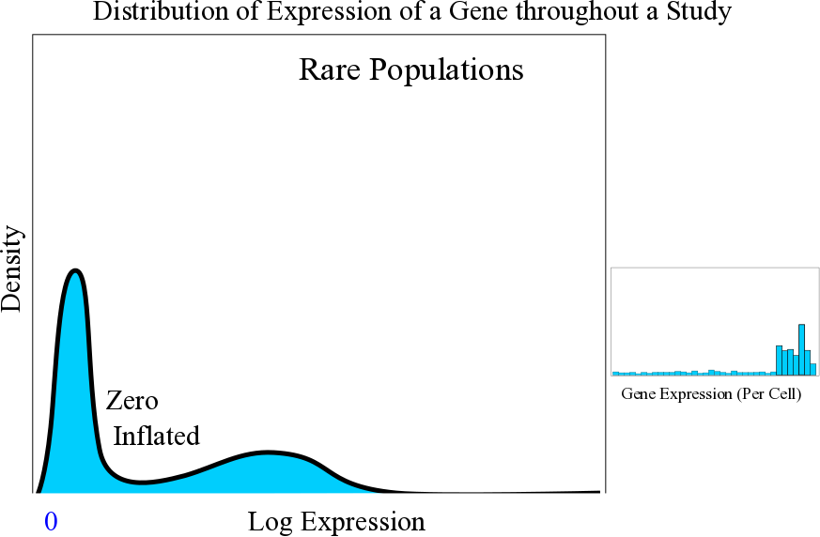
Genes Have Different Distributions

Slide 11
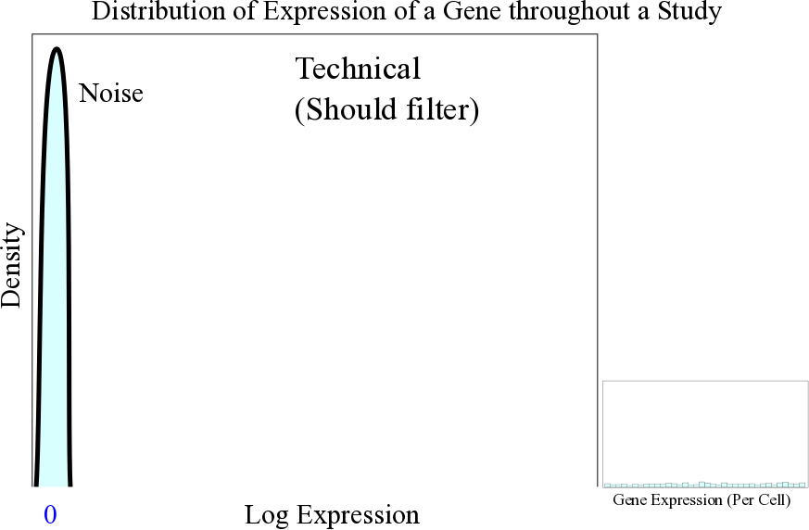
Genes Have Different Distributions

Slide 12
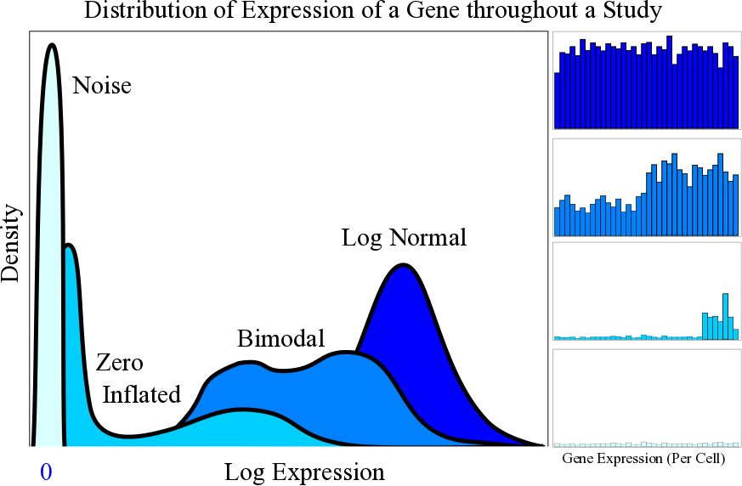
Genes Have Different Distributions

Slide 13
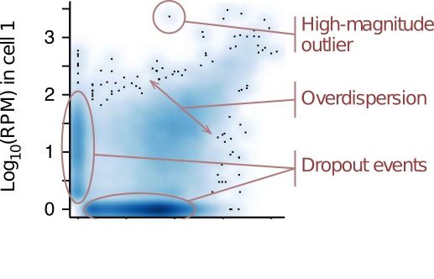
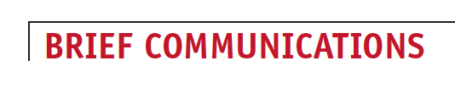
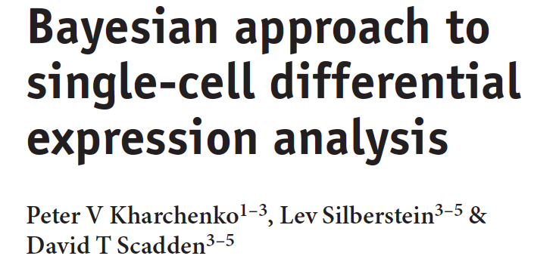

Underlying Biology
Zero inflation.
Drop-out event during reverse-transcription.
Genes with more expression have less zeros.
Complexity varies.
Transcription stochasticity.
Transcription bursting.
Coordinated transcription of multigene networks.
Over-dispersed counts.
Higher Resolution.
More sources of signal

Slide 14
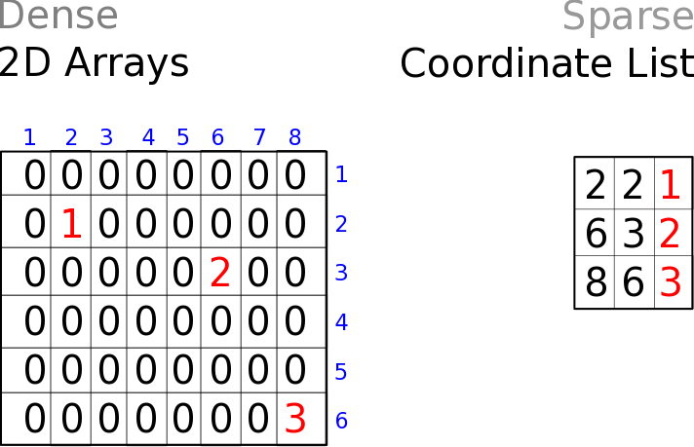
2D Arrays vs Coordinate Lists
Can be optimal for dense matrices
More optimal for sparse matrices
VS

Slide 15
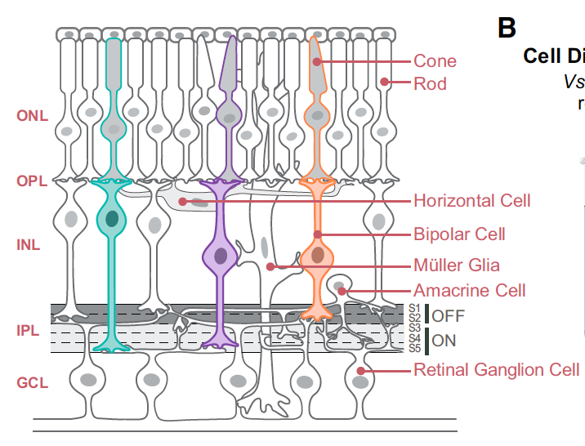
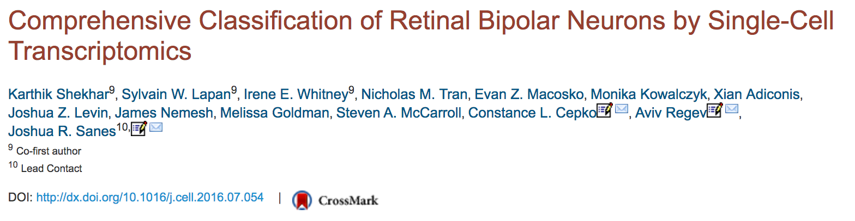


Today’s Data
To generate a comprehensive, validated classification scheme for the bipolar cells of the mouse retina.
Cone or rod type, ON or OFF, 9-12 subtypes (morphological)
~44k cells from a transgenic mouse line marking BCs
After filtering 27k (we use 3k)

Slide 16
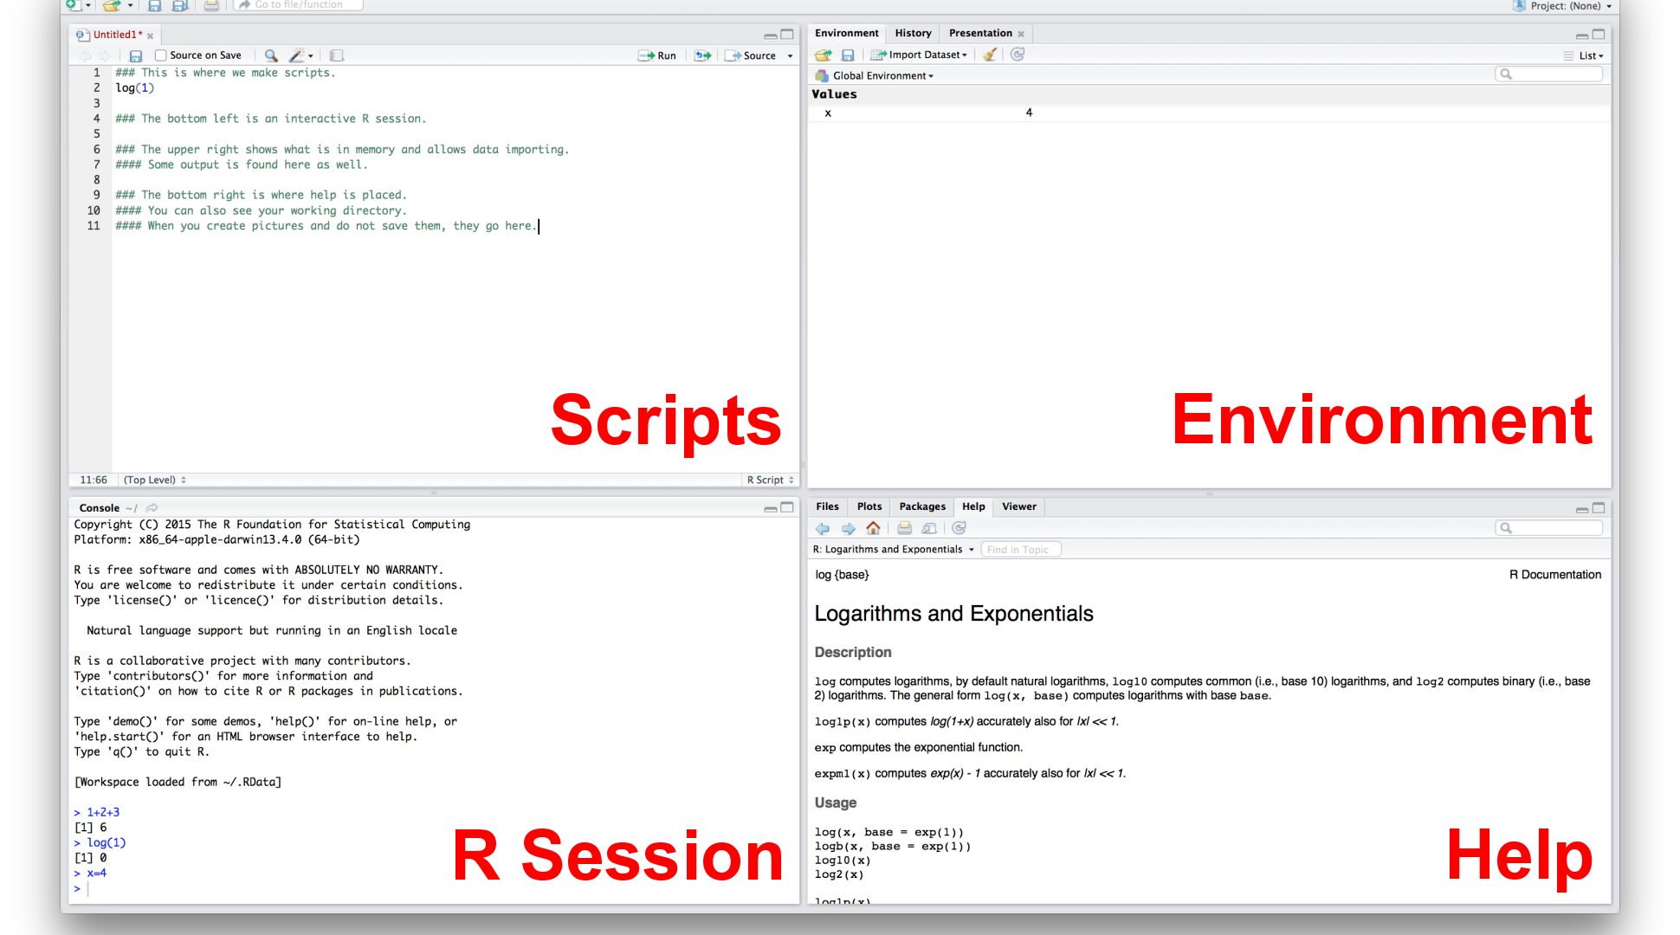
RStudio (IDE)

Slide 17

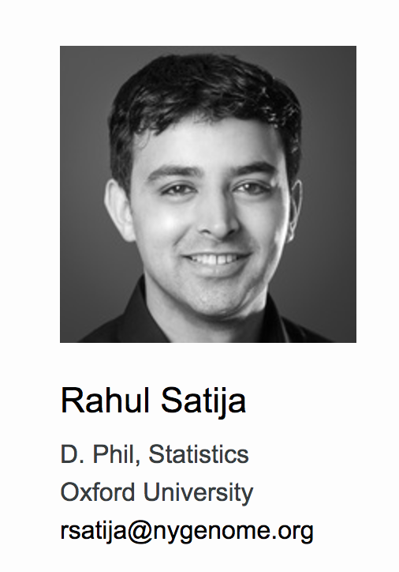
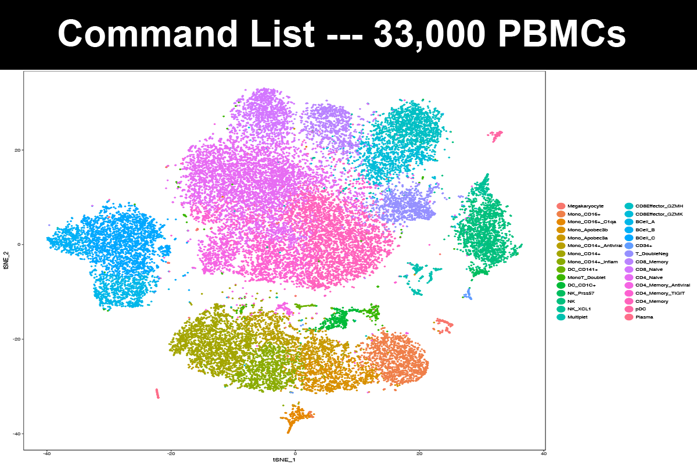
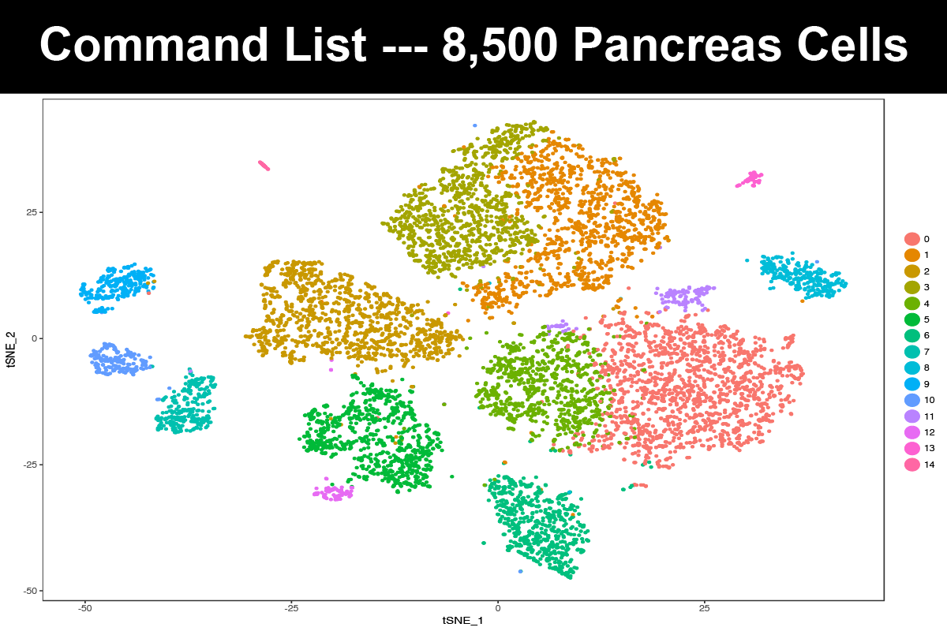

Slide 18
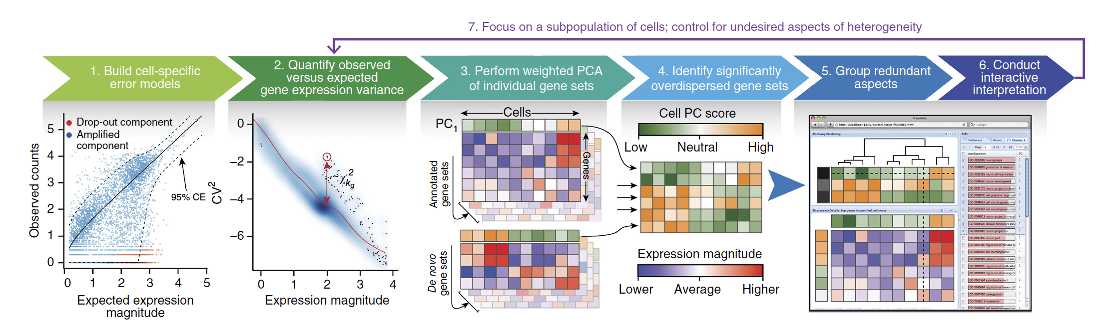
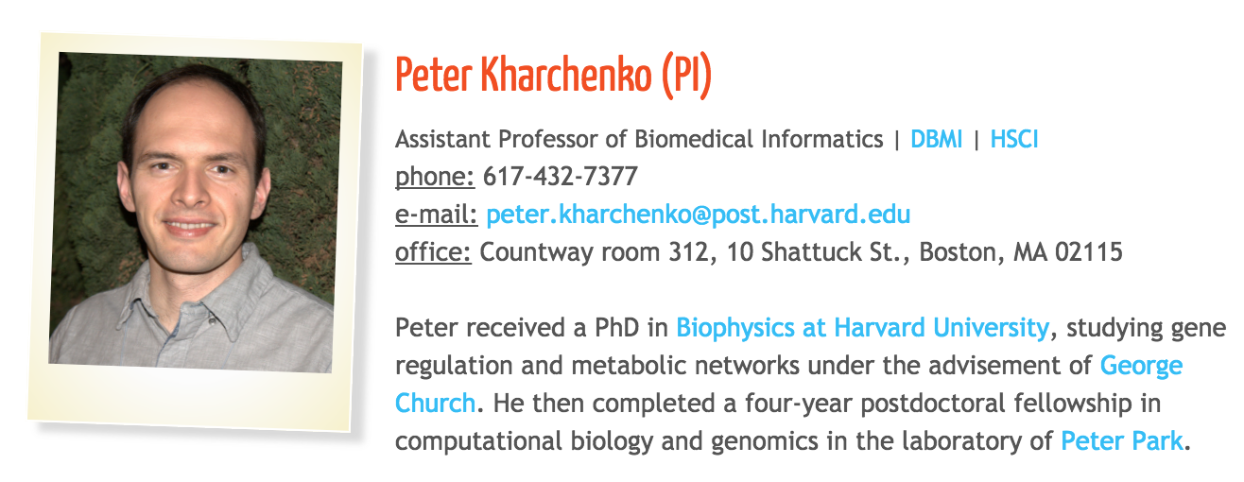
Characterizing transcriptional heterogeneity through pathway and gene set overdispersion analysis
Pagoda

Slide 19
The tutorial and sample data are available here:
https://github.com/broadinstitute/CEGS_single_cell_tx_workshop_Sept2017

Slide 20


Additional Helpful Resources
Highly recommended, $30 on Amazon, also free on-line.
Free for the time being.

Slide 21
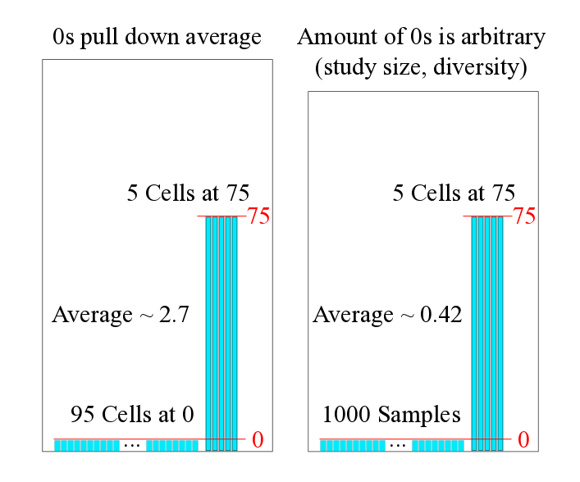
Filtering Genes: Averages are Less Useful

Slide 22

Single Cell RNA-Seq and Batch Affects

Slide 23
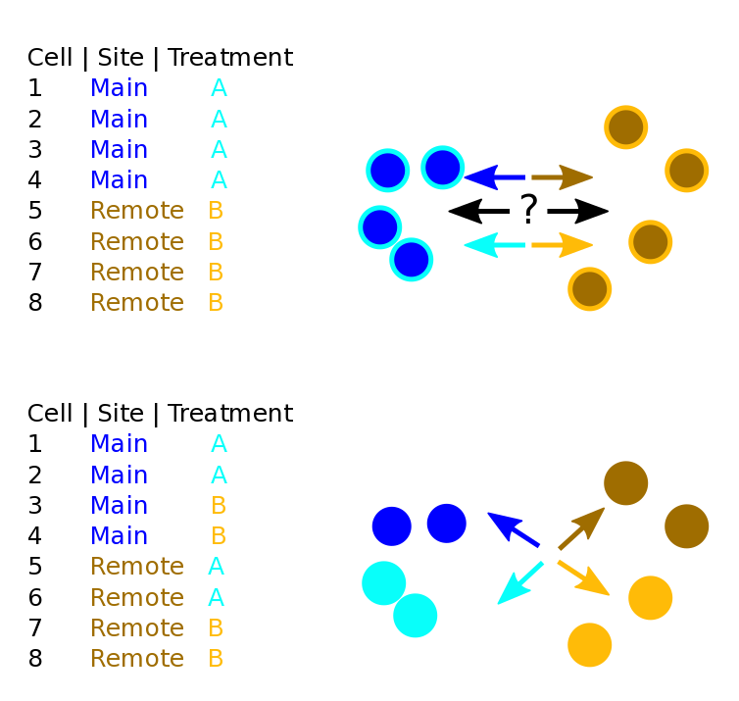
What is Study Confounding?

Slide 24
What is Study Confounding?

Slide 25
Dimensionality Reduction
Start with many measurements (high dimensional).
Want to reduce to few features (lower-dimensional space).
One way is to extract features based on capturing groups of variance.
We need this to plot the cells in 2D (or ordinate them)
In scRNA-Seq PC1 may be complexity.

Slide 26
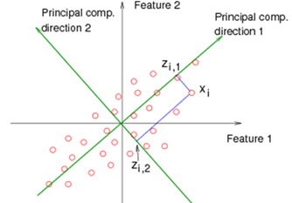
PCA: in Quick Theory
Find orthogonal groups of variance.
Given from most to least variance.
Components of variation.
Linear combinations explaining the variance.

Slide 27

PCA – identifying maximal orthogonal sources of variation
From: https://stats.stackexchange.com/questions/2691/making-sense-of-principal-component-analysis-eigenvectors-eigenvalues

Slide 28
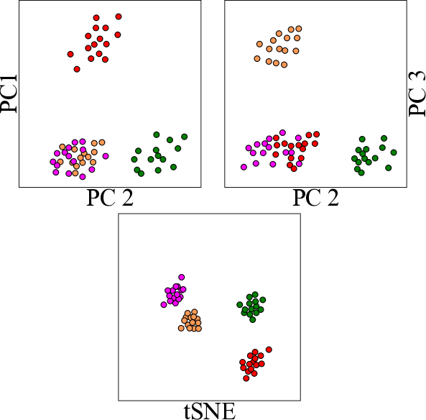
PCA of single cell data

Slide 29
PCA of single cell data

Slide 30
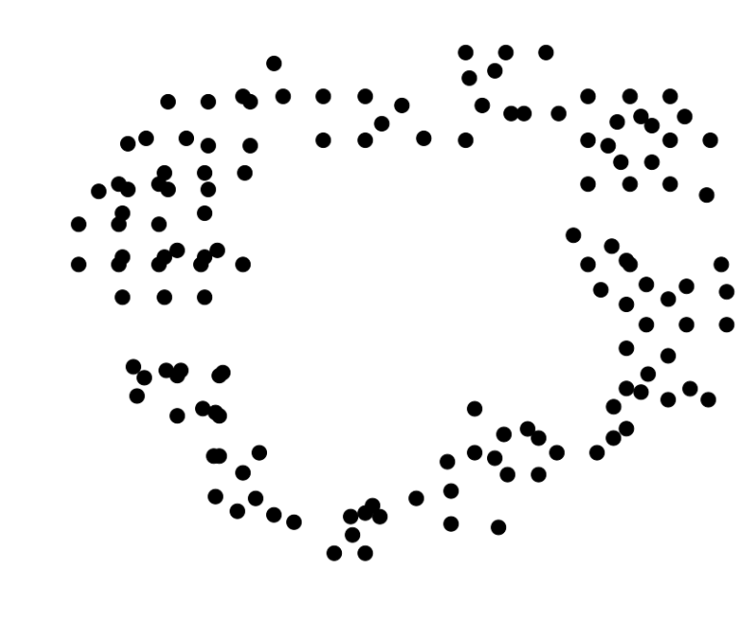
t-SNE: Nonlinear Dimensional Reduction

Slide 31
t-SNE: Collapsing the Visualization to 2D

Slide 32
Learn More About t-SNE
Awesome Blog on t-SNE parameterization
http://distill.pub/2016/misread-tsne
Publication
https://lvdmaaten.github.io/publications/papers/JMLR_2008.pdf
Nice YouTube Video
https://www.youtube.com/watch?v=RJVL80Gg3lA
Code
https://lvdmaaten.github.io/tsne/
Interactive Tensor flow
http://projector.tensorflow.org/

Slide 33
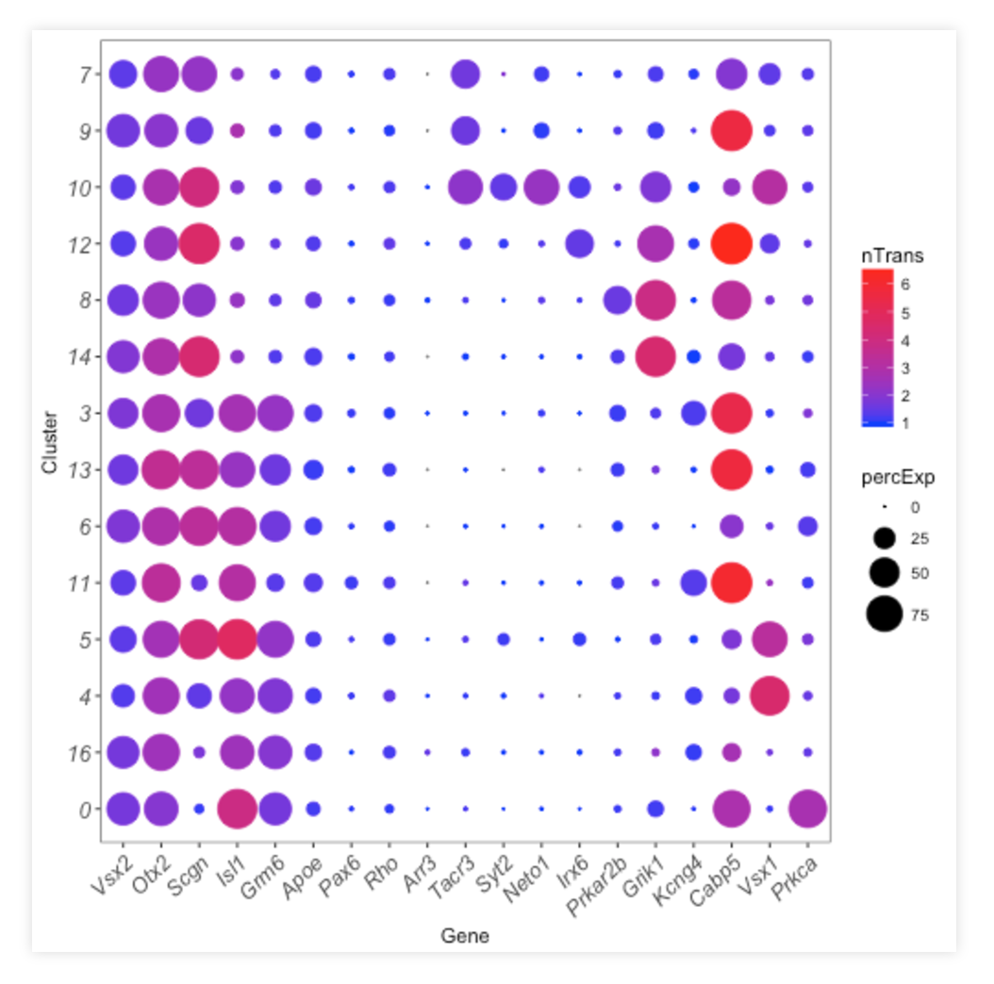
Dot plots
prevalent genes
sparse genes
Size of circle
Gene prevalence in cluster.
Color of circle
More red, more expressed in cluster.
Scales well with many cells.
lowly
expressed
highly
expressed
very
specific

Slide 34
Section: Wrapping Up What Did We Miss (So Much)?
So much more to learn!
We covered this

Slide 35
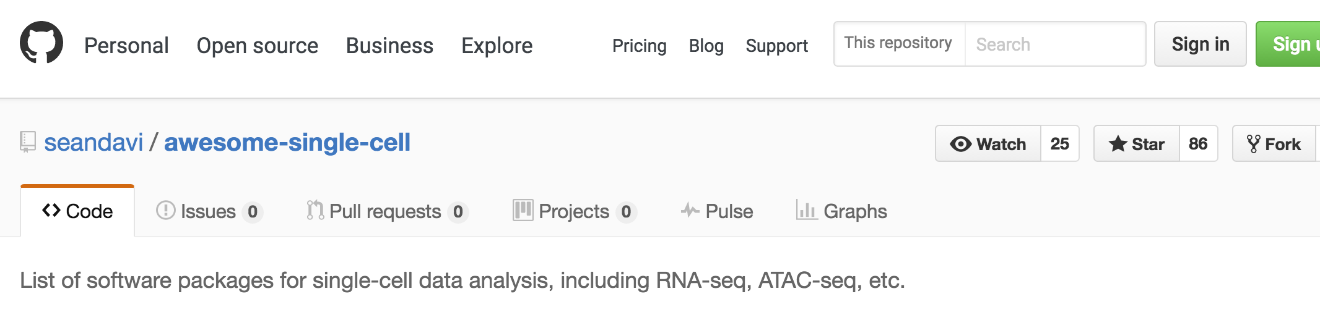
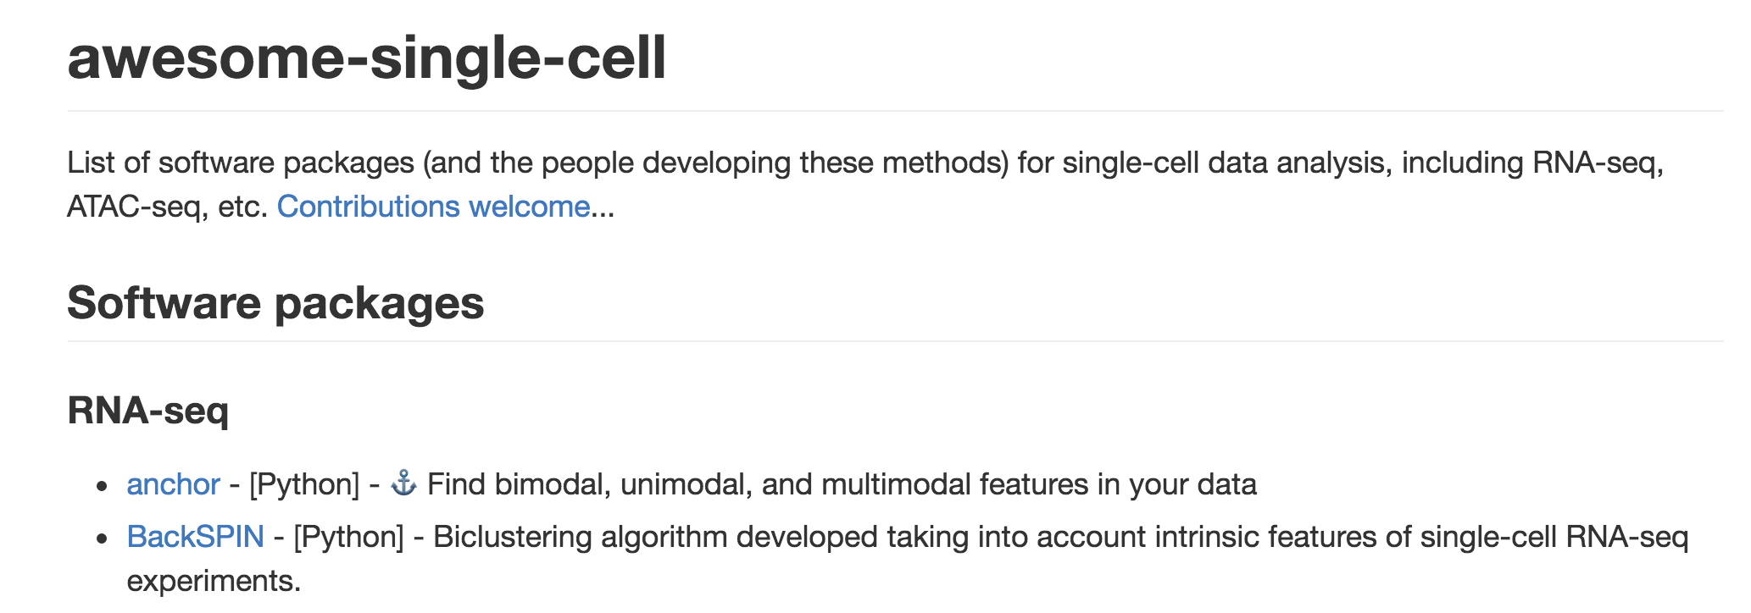
Awesome List
https://github.com/seandavi/awesome-single-cell

Slide 36
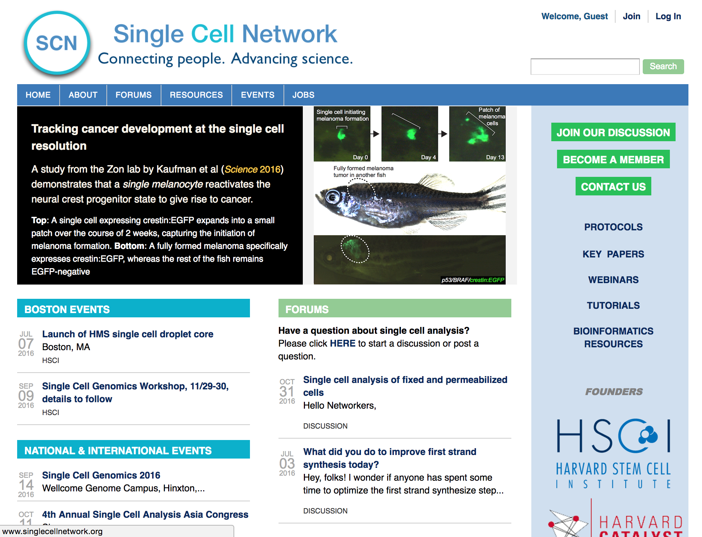
Single Cell Network
www.singlecellnetwork.org

